Slide 1
Welcome to Steeple Bumpstead Parish Council Annual Village Meeting 2021
www.steeplebumpstead-pc.org

Slide 2
Agenda
Welcome from the Chairman
Presentation From Catesby Estates – Haverhill Vales
Reports from County & District Councillor
Chairman’s report incorporating Clerk’s report data
Presentation from Guest Speakers
Date of next meeting – Wednesday 20th April 2022
Chairman to close the meeting

Slide 3
Catesby Estates Presentation Haverhill Vales
Notes:
Please see PDF presentation

Slide 4
County Councillor Cllr David Finch david.finch@essex.gov.uk

Slide 5
District Councillor Cllr Diana Garrod cllr.dgarrod@braintree.gov.uk

Slide 6
Chairman’s Report Cllr Kerry Barnes chairman@steeplebumpstead-pc.org

Slide 7
So what did we spend your money on?
Description | Amount
Camping Close and Play Equipment | £6,977
Footpaths, Humphrey’s Meadow and Amenity areas | £7,330
Churchyard and Cemetery | £3,000
Street lighting | £798
Hall hire & Meetings | £1,010
Insurance | £1,205
Admin & Wages | £14,320
Other | £270
Total Expenditure | £31,950
Notes:
Other is Library Honorarium and Neighbourhood plan.

Slide 8
Additional Grants we have won
Description | Amount
Community Initiative Fund - Camping Close repairs and Play Equipment These funds were to go toward essential repairs to the enclosed play area and | £2,500
Community Initiative Fund - Handyman Project These funds were to appoint a handyman and catch up on some areas that have been overlooked | £1,300
District Councillor Grant - Steeple Bumpstead Neighbourhood Network The Parish Council simply ‘caretake’ over this fund which has been put to excellent use in the community, helping residents. | £1,000
Total Expenditure | £4,300
Notes:
Other is Library Honorarium and Neighbourhood plan.

Slide 9
Communication with the Parish Council

Slide 10
Communication with the Parish Council
Notes:
Streetlighting was a hot topic, 7 of the PC lights needed replacement due to power surges. ECC lights also needed repairs. Dog fouling and FIDO bins have been causing concern too, though mostly shared on FB and so not recorded as a report.

Slide 11
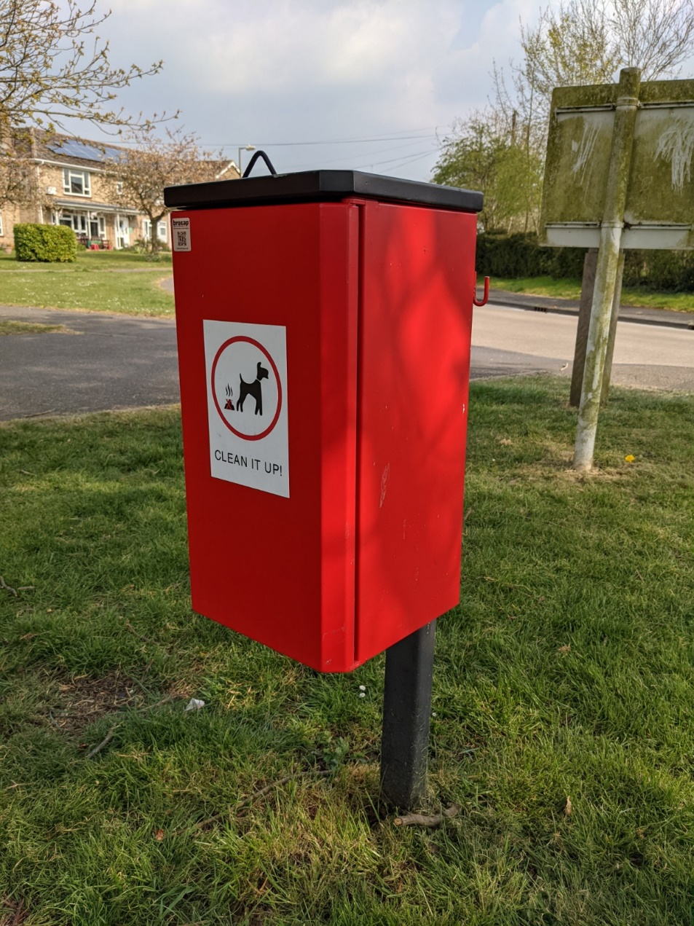
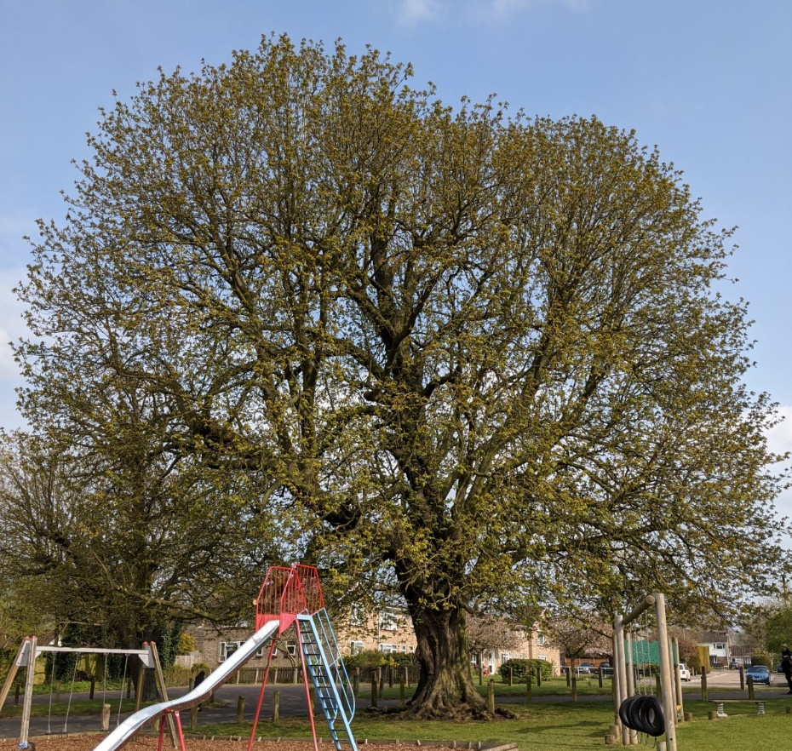

Slide 12
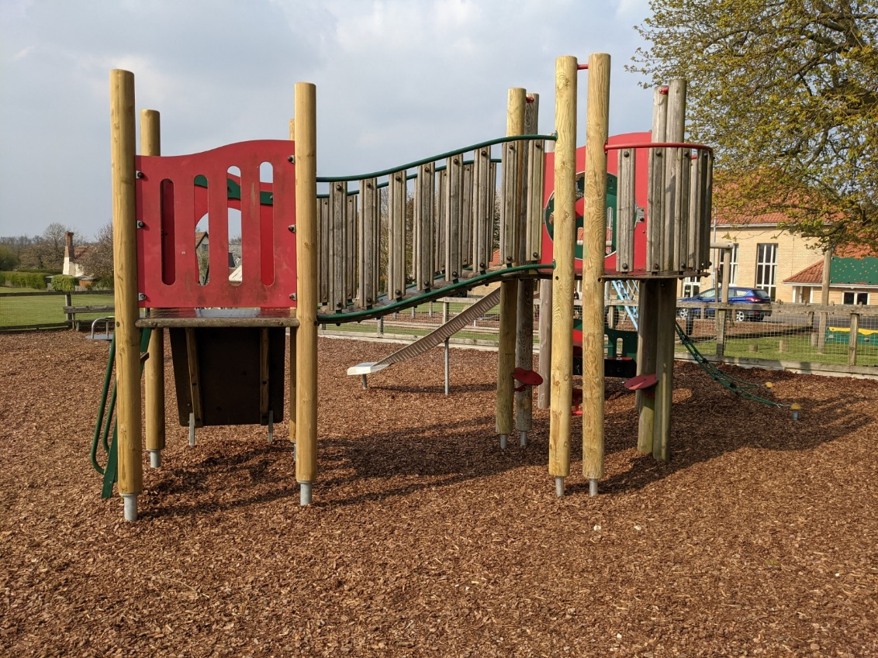
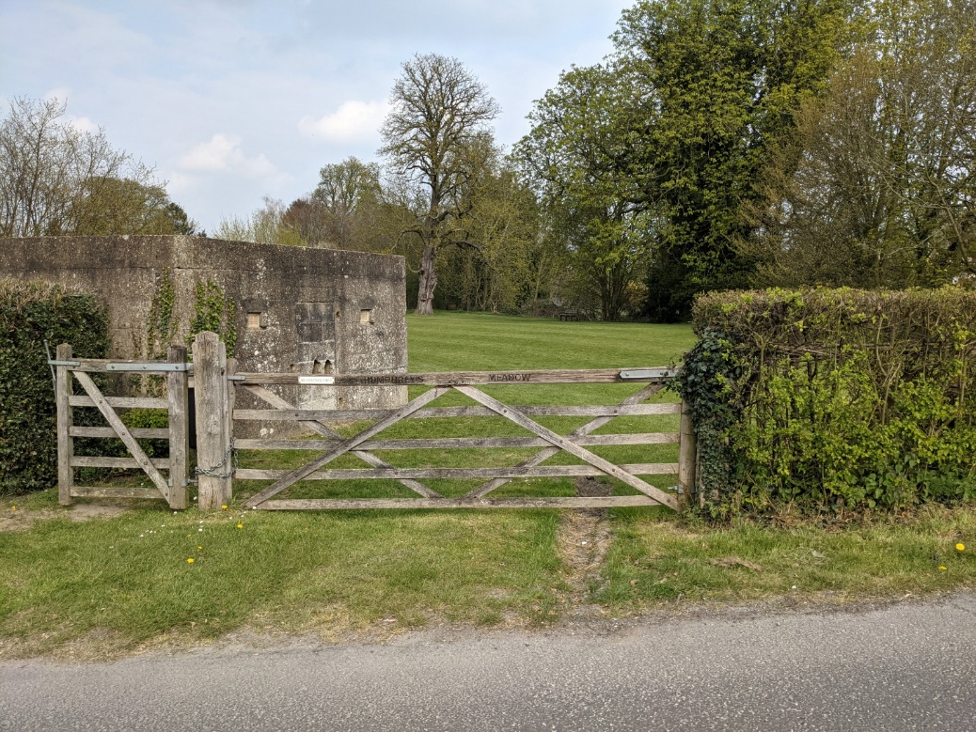

Slide 13
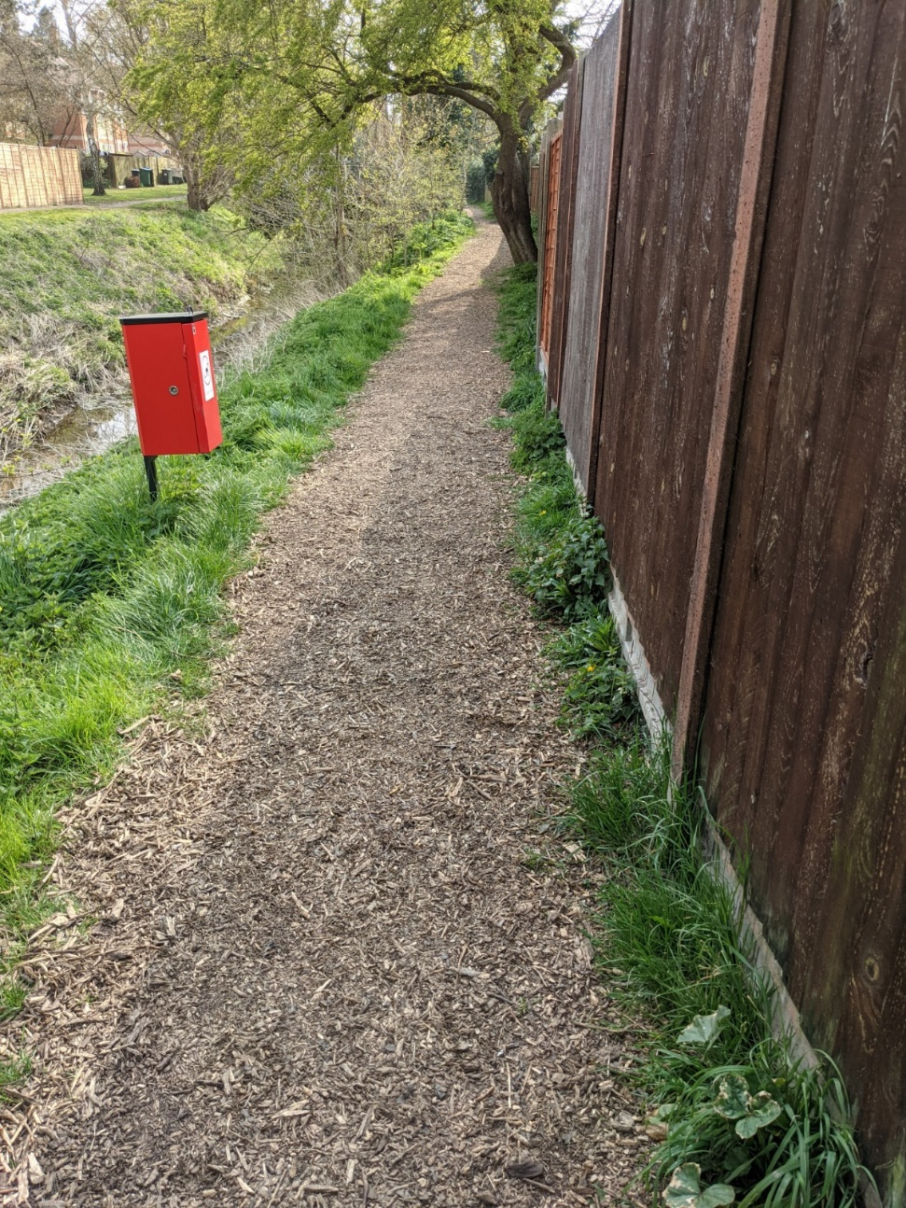
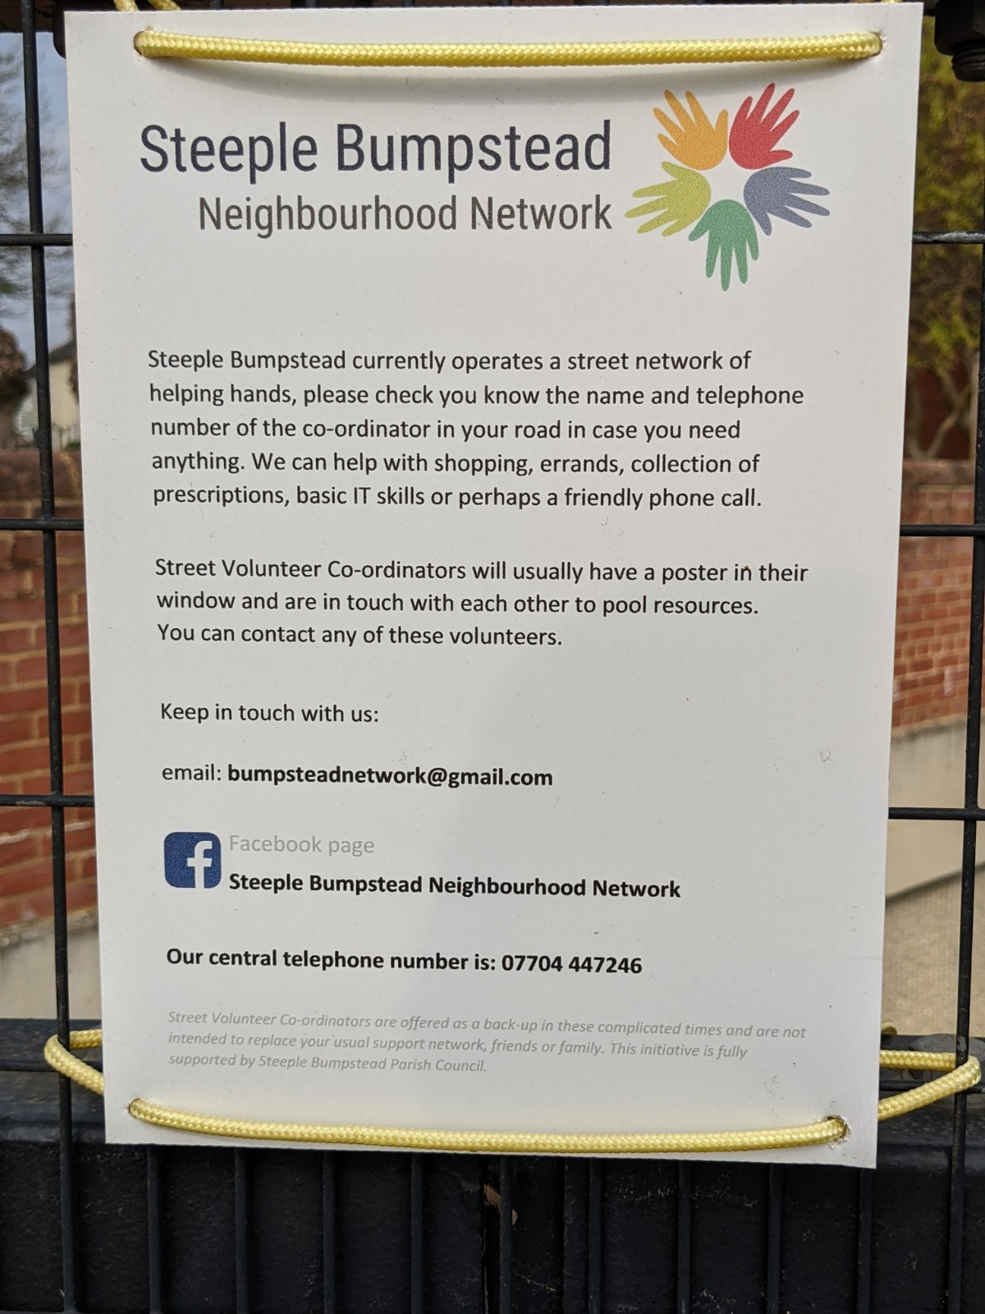

Slide 14
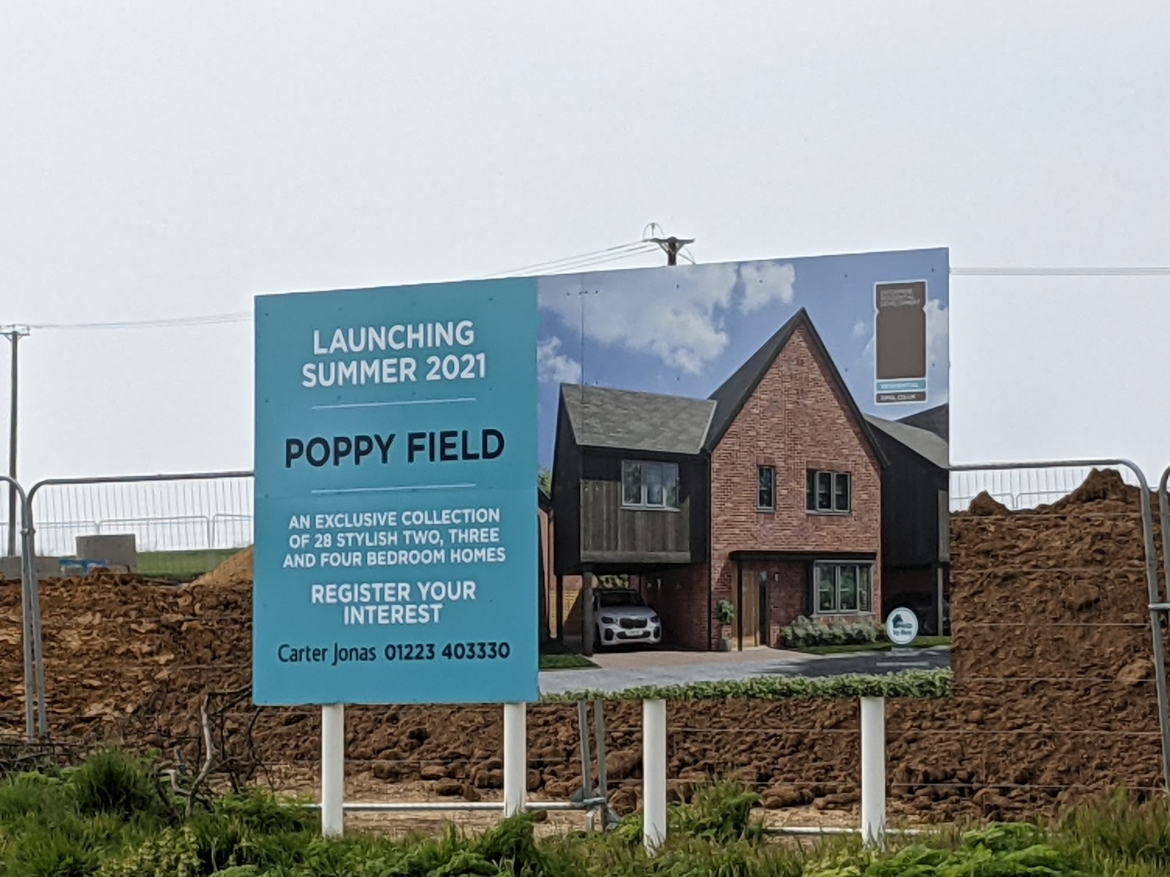

Slide 15
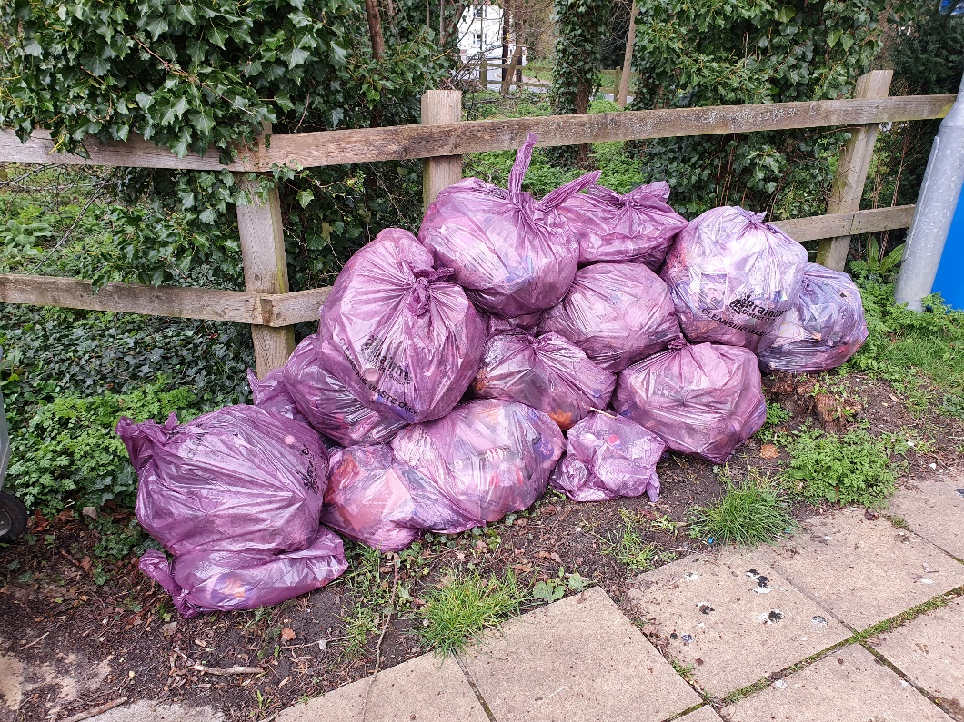
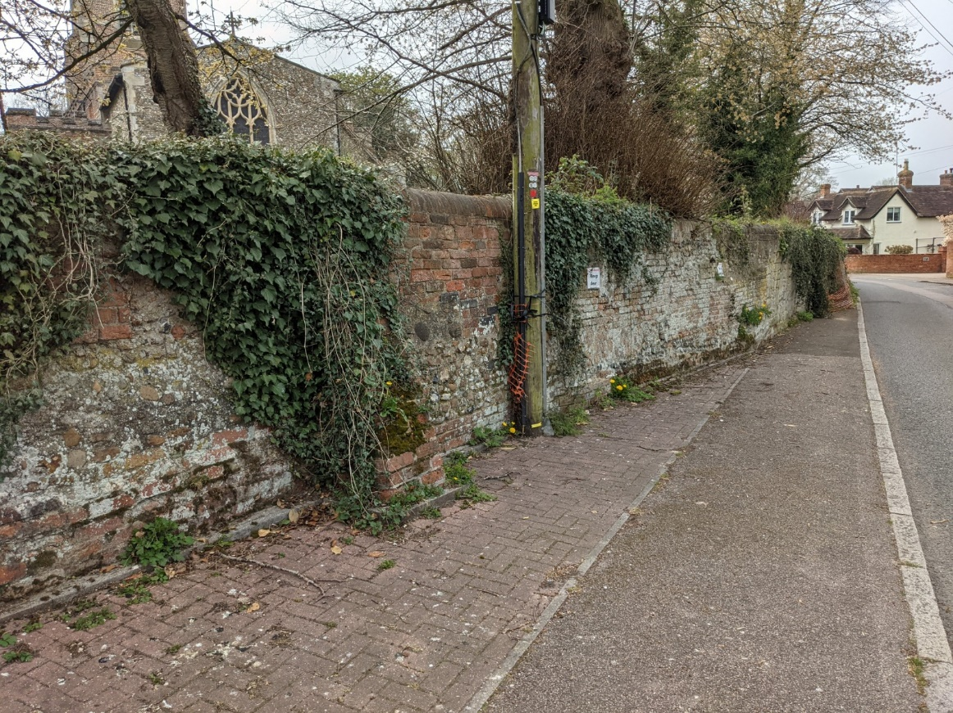

Slide 16
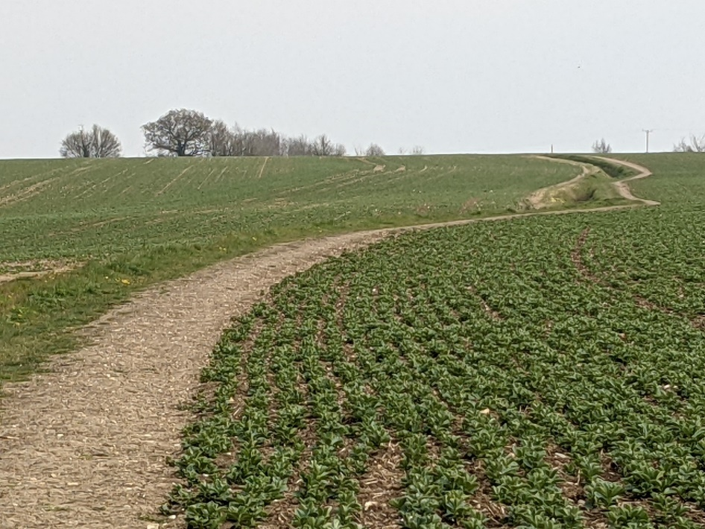
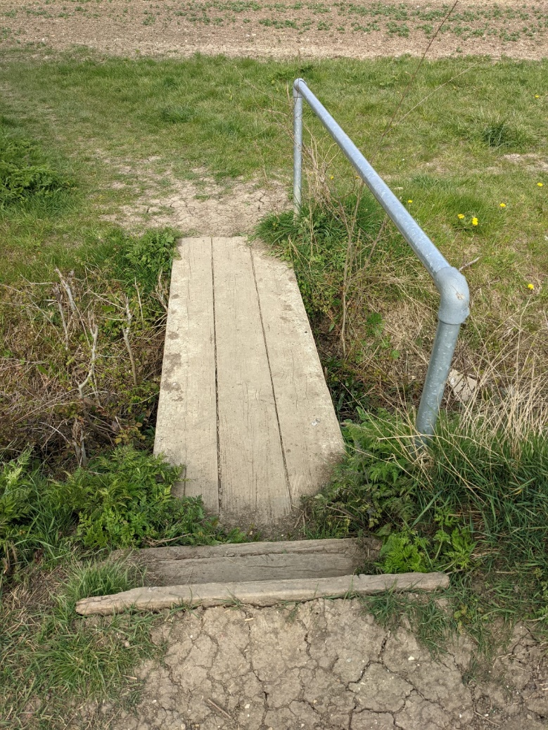
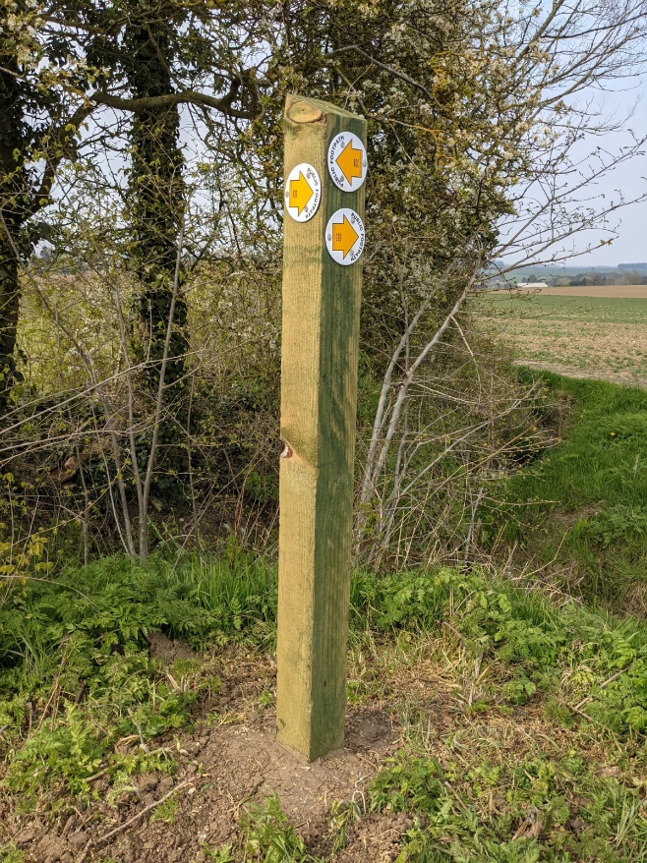

Slide 17
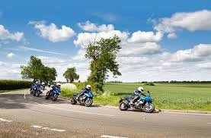
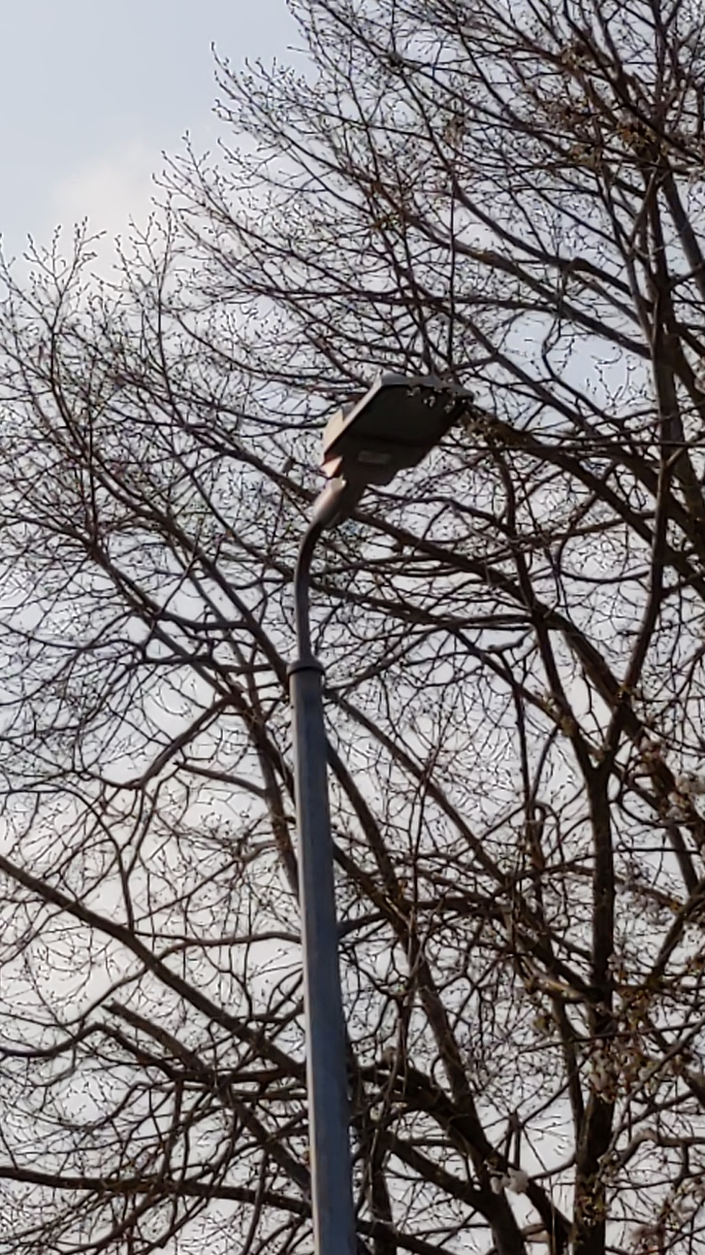

Slide 19
Presentation from Guest Speakers
Running Order
Braintree Community Policing Team - PC James Draper
SBNN – Catherine Condie
The Steele Chasers Running Group - Kerry Barnes
The Bowls Club – Dave Kuyper (tbc)
Steeple Bumpstead Congregational Church – Revd Sophia Girvan
Cavell community choir – Revd Theresa Lowe
1st Steeple Bumpstead Scout Group – Chris Bailey
Steeple Wombles – Debbie Hartshorn
Notes:
Time for a comfort break before moving to the guest speakers.

Slide 20
Reports from those unable to attend to be read by others
Village Library – Sheila Walsh
Steeple Bumpstead Golf Society – Michael Maloney
Bootcamp – Nigel Chapman
Dynamos – Kevin Tabron
Players & Junipers – Steph Manning
SBWEG – Jenny Nash
Steeple Bumpstead Brownies and Guides

Slide 21
Village Library – Sheila Walsh
With the Moot Hall’s door open once again on May 18th, after all the past mostly inactive months, we hope, on Tuesday afternoons, to welcome members along with others who may have rediscovered the joy of books. While there are to be changes within the structure of Essex Libraries Service, as it becomes part of a South East Consortium, I have had assurances from the Supervisor at Saffron Walden, that once this is established, our excellent relationship will continue since she sees us as a supportive asset in keeping her library viable. An advantage of there being a consortium should mean access to books on request over and above those held within the Essex catalogue. Though initially I will not be able to offer to offer books other than those on our shelves, I will reinstate the Request Service as soon as possible. I hope to arrange a complete changeover of our stock within the next month or so when I will have spent time in Saffron Walden making a selection of 500 books across all genres. As I noted in the invaluable Yellow Book (February/March) there are some 60 books out on loan and while not pressing for their immediate return, I am hopeful to see most of these via my gentle reminders.
I also noted in the YB Sue King having given up her role as assistant along with my appreciation of her quiet efficiency. My daughter Katharine (Kate Haywood) has encouraged and enabled my continuing as librarian by becoming both my chauffer and assistant.
I am sure it will have been noted with regret elsewhere, that George Cuthbert died in March. George had been a delightful stalwart of the library for many years, long before my tenure, until about 18 months ago. His quiet reminiscences were always so welcome and it had been my pleasure to obtain books for him, not least several relating to WW2 Royal Navy, his having served in Destroyers from the age of 18.
As is now the sensible precautionary custom, those entering the library will need to wear masks, otherwise the warmth of welcome will be as always.
Sheila Walsh

Slide 22
Steeple Bumpstead Golf Society– Michael Maloney
The Steeple Bumpstead Golf Society (SBGS) has been established in the village for over 30 years and with a membership of close to 40 continues to thrive.
Clearly 2020 was a difficult year for all and with many venues closed for much of the year the Society only managed a couple of events which given the constraints around social distancing were somewhat sterile and the antithesis of what the Society is about i.e. social interaction. Nevertheless we have a programme of events planned for 2021 and whilst we have had to postpone our first two events of the year in April and May we fully expect to be in play in June at Ely GC as lockdown lifts.
SBGS in a normal year would have seven meetings from April to October, usually held on a Friday around the middle of each month and we visit golf courses in Suffolk, Norfolk,Essex and Cambs with the odd foray in Hertfordshire. The general rule is that we keep travel to a maximum of one hour from the village. Our golf days usually consist of either 18 or 27 holes with a combination of breakfast, lunch and dinner and sometimes all three! The cost of a day varies depending on the quality of the course we visit but generally we charge around £55-60 for a full day of golf and food.
The cost of annual membership is £15 and is usually payable at our AGM which is normally held in February each year.
SBGS would welcome new members whether they are from Steeple Bumpstead or the surrounding areas and if anyone is interested I can be contacted as follows:
Email: mickmaloney57@gmail.com
Mobile: 07764 146857
Mick Maloney – SBGS Secretary

Slide 23
Bootcamp – Nigel Chapman
Bumpstead Boot Camp is in its seventh year.
An exercise session for all levels of fitness. Pay as you go. £3.50 for an hour session.
We currently do all classes outside on the basketball court on the Camping Close, Steeple Bumpstead.
Group size can be anything from 3 to 15 people. Children are welcome as long as with a parent or guardian.
Session content varies every week to avoid the boredom of repetition.
Notice given if the weather isn't suitable to go ahead.
No special equipment needed by participants. Just bring a drink.
We are currently working with Covid restrictions in mind.
Sessions run throughout the year.
Facebook page and WhatsApp group for members.
New members always welcome.

Slide 24
Dynamos – Kelvin Tabron

Slide 25
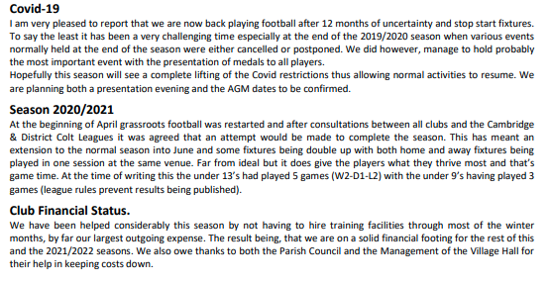
Dynamos – Kelvin Tabron

Slide 26
Dynamos – Kelvin Tabron

Slide 27
Players and Junipers – Steph (1 of 2)
2020 started off so well.
In February 2020, our Pantomime, Alice In Wonderland was yet another wonderful family show well attended by the local community, this was our 57th Winter production (about 52 pantos and 5 Christmas Variety Shows).
As always, we received an enthusiastic and grateful response from our audience which makes all the effort worthwhile, and as a society we love sharing this unique experience together.
We didn’t know then that this was sadly to be last time we’d be together as a company for over a year.
It became apparent in March 2020 the struggles that we, like all theatres and societies, were to be going to face because the Covid19 restrictions and we had to consider not only the welfare of our Junipers but also a duty of care we had to the wider community (extending educational bubbles and use of the community village hall).
We knew that the experience we all loved would not be the same as before for us and of course our beloved audiences. Better to be able to present the Panto we know and love when it’s safe to do so.
Therefore, with a heavy heart, the SB Players Committee took a unanimous decision that for the foreseeable future it would not be viable to hold Junipers or rehearse and perform a Pantomime in time for our familiar slot in Feb 2021.
Our hearts were a little broken.

Slide 28
Players and Junipers – Steph (2 of 2)
However, hope was on the horizon…
The whole company put together a remarkable “Lockdown Production” for the summer 2020. With a carefully structured script, editing wizardry, using our own mobile phones, costumes, lounges, bathrooms and gardens, Players and Junipers were proud to present a virtual murder mystery; Horror Returns to Harrington Hall.
It was streamed on YouTube in June 2020 and free to our audiences.. We requested a donation to support our community buildings – The Village Hall, The Moot Hall, St Mary’s Church and the Congregational Church, - all charities dependent on fundraising events to support their upkeep -events they have not been able to host this pandemic year.
The Murder Mystery was a resounding success and to date we have raised about £400 to share amongst the charities.
It is still available to watch and for people donate!
Also, our costume lady has cleared out a lot of old costumes and props – which will set up nicely for our next production.
We are reviewing the rules as we go and hope to start rehearsing in September 2021 for Panto 2022!
So, 2021 is looking brighter ahead!

Slide 29
SBWEG – Steeple Bumpstead Wildlife and Environment Group
Despite the obvious restrictions over the last year, Steeple Bumpstead Wildlife and Environment Group have continued with projects in the village.
We continued to work on the ditch on Bellropes abutting Broadgate House (initially helped by the Dedham Vale and Stour Valley Volunteers the previous year) clearing and cutting back with the brash used to create habitat piles. Adding to the piles the cut long grass raked from the ‘wildflower meadow’ area, which was created for the first time last year.
Trees and shrubs (thanks to the Parish Council for funds) have been planted alongside the ditch to increase biodiversity and for specific species to feed on.
The preschool forest school area copse, which was potentially dangerous for the little ones, has been cut back and cleared and with a volunteer (thanks Paul) with a mini digger all the old plastic matting dug out and removed and taken to the tip (thanks Kit). And donated bird boxes (thank you Peter) put up. Finally, it has been replanted with more trees and shrubs funded by the Parish Council (thanks).

Slide 30
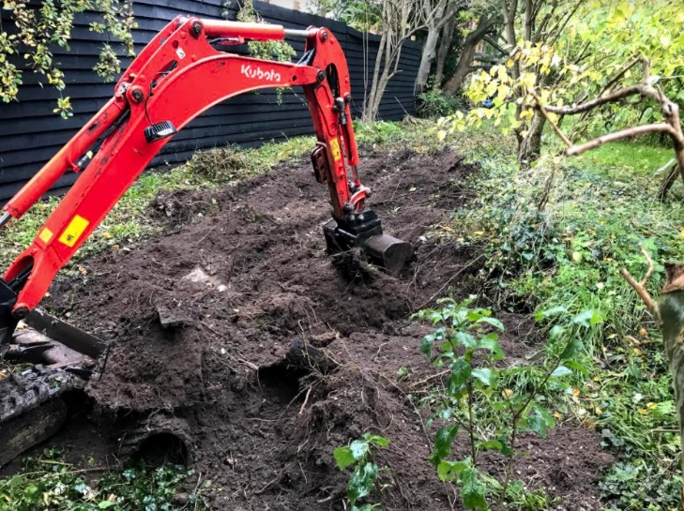
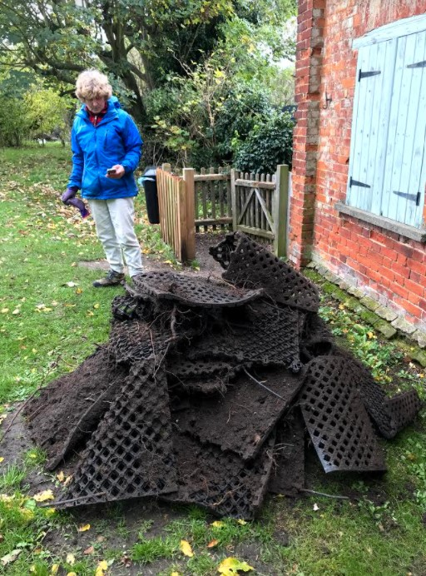
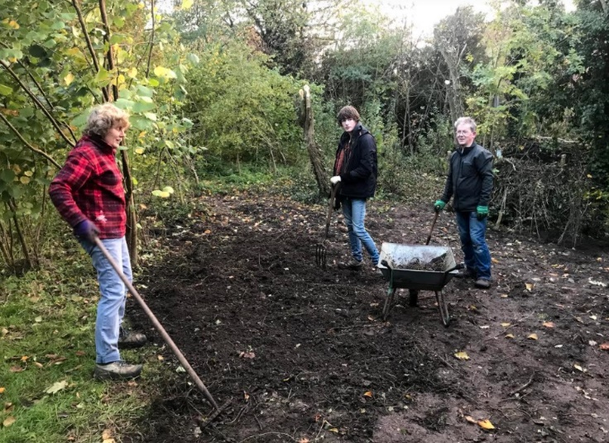
SBWEG – Wildlife and Environmental Group
Creating a Dead Hedge
Digging up plastic at the Preschool forest school site

Slide 31
SBWEG – Wildlife and Environmental Group
The brash cut down by the electricity board in the Plantation has been cleared and added to the existing dead hedge – we politely request that this area is not used as a dumping ground by other village organisations, but they are welcome to cut up their brash and add it to the dead hedges or the compost bins, if suitable for composting.
Donated woodchip (thanks Matt) has continued to be spread throughout the winter along the riverside walk and once by the village allotments.
We coppiced one of the three hazels in Humphrey’s Meadow, some of which we used as poles for the dead hedging.
The fruit trees we planted as part of the Scattered Orchard Project have been pruned; some in the winter and others in the summer, according to their needs (stone fruit in the summer and apples and pears in the dormant stage or shortly after fruiting).
And at the request of the Parish Council, for safety and access, some of the lower limbs of some of the established trees on Camping Close were trimmed.

Slide 32
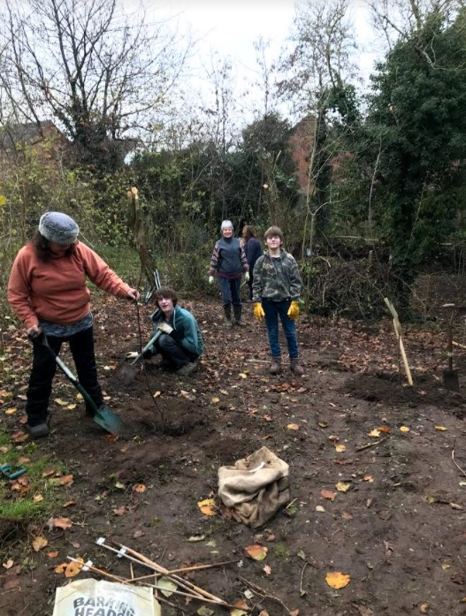
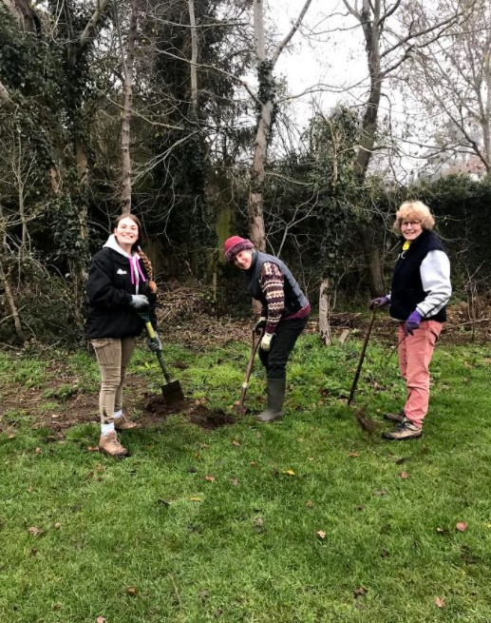
SBWEG – Wildlife and Environmental Group
Planting Fruit trees donated by the Parish Council

Slide 33
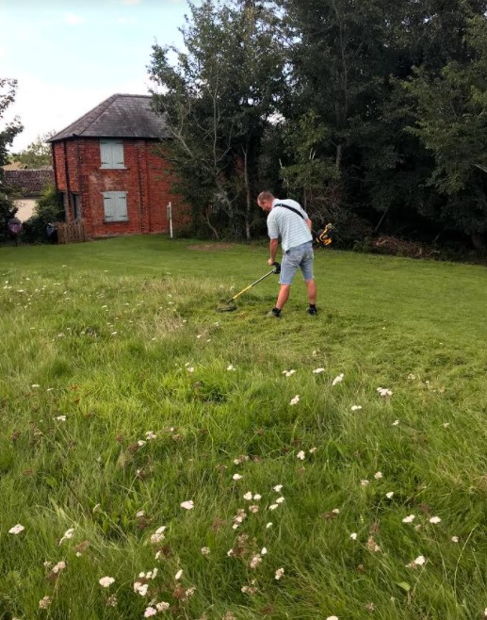
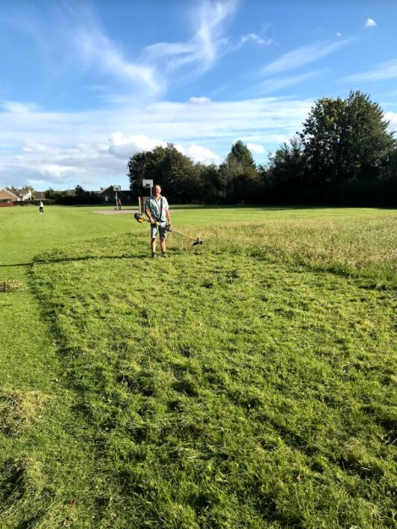
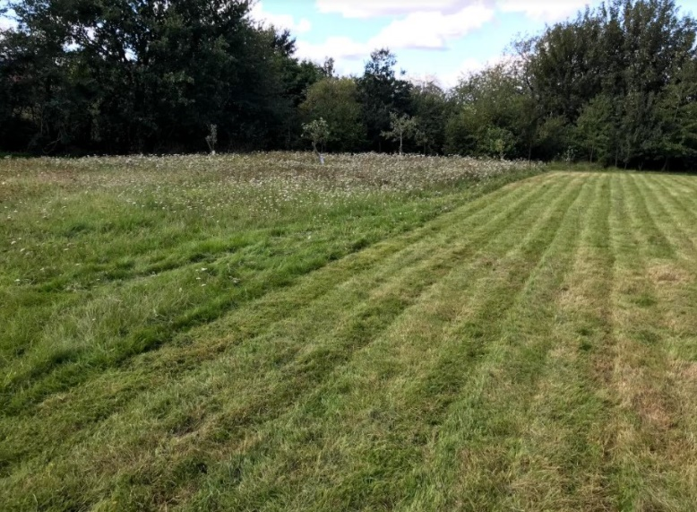
SBWEG – Steeple Bumpstead Wildlife and Environment Group
And finally, we continue to write in the Yellow Book, post on our Facebook Page, liaise with the Dedham Vale and Stour Valley Project (who have helped us in previous years) and generally talk to villagers as we work around the village, promoting the idea of looking after our village for the benefit of wildlife and the environment and encourage volunteering, whether regular or occasional.
We would always welcome more help and thank those who currently support us.

Slide 34
Steeple Bumpstead Brownies and Guides
Guiding in Steeple Bumpstead has been able to continue through the pandemic by using Zoom for our weekly meetings. We thought it was important for the girl’s mental health to stay connected to their friends. We have adapted our activities depending on the national circumstances so reducing looking at the screens between Jan – Feb as they were using them for school and so doing more creative activities instead. Our groups have been able to support several girls experiencing social problems at school by giving them something away from school to look forward to every week. Our membership numbers for both groups have remained stable throughout and new girls have joined.

Slide 35
Steeple Bumpstead Brownies and Guides
We try to do a different type of activity every week. The Guides favourite activities have been BBQ’s in our gardens whilst Zooming together, getting their hammers and nails out to make tin-can lanterns, chill-out session making natural face packs and skin scrubs. They have enjoyed escape rooms and Taskmaster, made lava-lamps, bionic hands and butter, learnt sign-language and magic tricks, tried whittling, several sessions cooking and crafting and had a visit from a Forensic Scientist. The Brownies have enjoyed lots of craft, cooking, scavenger hunts and duck races, made bug hotels and vortexers, introduced their pets to us and learnt about DNA. We have had two Brownies achieve the top award (Gold) for their age group., for which we are very proud of them and hope more will follow soon.
Both groups marked Remembrance Sunday at home and contributed to Children In Need by joining the Act Your Age Challenge for which we had; baking, sign-language, exercise, artwork and instrument playing raising £124 between them.
Virtual Guiding has been a new challenge to us all but we have all learnt new IT skills (some from the girls) and it has provided us with the opportunity to do some activities that would be difficult to do in-person. It has also let us get to know the families a bit more.
We’re looking forward to meeting in-person soon with plenty of outdoor activities. If anyone knows of a suitable area for the girls to practice their fire-lighting skills or any projects they could be involved in, please could you contact me (Sandra Buck details in the Yellow Book).

Slide 36
Next Meeting Wednesday 20th April 2022
Notes:
To include housekeeping and reference to no meeting last year ergo no minutes to confirm. The minutes from this meeting will be agreed at the PC meeting in June.

Slide 37
Steeple Bumpstead Parish Council
www.steeplebumpstead-pc.org
Notes:
Chairman to close the meeting

