Slide 1
Welcome to Steeple Bumpstead Annual Village Meeting 20th April 2022
www.steeplebumpstead-pc.org

Slide 2
Agenda
Welcome from the Chairman & apologies
Approve Minutes of the last meeting
Presentation From Cllr Ian Mackenzie re: Platinum Jubilee Celebrations
Reports from County & District Councillor
Chairman’s report incorporating Clerk’s report data
SBPC Neighbourhood Plan
Presentation from Village Groups / Guest Speakers
Date of next meeting – Wednesday 19th April 2023
Chairman to close the meeting

Slide 3
Cllr Ian Mackenzie The Queen’s Platinum Jubilee June 2nd-5th 2022
Notes:
Please see PDF presentation

Slide 4
Timetable of events
Day | Time | Event | Location
Monday 30th May to Sunday 5th June |  | Best dressed House Best Scarecrow | Throughout village
Thursday 2nd June
 | 15:30 – 21:30 | Children’s drawing exhibition in Moot Hall | Moot Hall
 | 14:00 | Vintage car show | Camping Close
 | 16:00 | Vintage Car Parade | Church Street
 | 16:45 | Thaxted Morris Men | Church Street
 | 17:30 | Wheelbarrow racing
 | 19:00 | Thaxted Morris Men | Church Street
 | 20:00 | Live Music
 | 21:30 | Beacon lighting parade | TBC
 | 20:00 | Lighting of Beacon | TBC
Notes:
Please see PDF presentation

Slide 5
Timetable of events
Friday 3rd June | 10:00? | Church Breakfast | St Mary’s Church
 | 11:00 | Live stream of National service from London
 | Pm | Afternoon teas | Congregational Church
Saturday 4th June | 10:30 | Bumpstead Royal Trail – judging of best dressed house & scarecrow | Village
 | ? | Invite your neighbours for morning Tea | Village
Sunday 5th June | 13:30 | Village picnic | Camping Close
 | 14:00 | Cavell Community Choir | Arena
 | 14:30 | Dog show | Camping Close
 | 14:30 | Afternoon teas at Church | St Mary’s Church
 | 15:00 | Children’s Races | Arena
 | 15:10 | Her Majesty’s Handicap Three-legged race | Arena
 | 15:40 | Her Majesty’s Gold Egg cup – Egg & Spoon Race | Arena
 | 16:10 | Her Majesty’s Platinum Jubilee Stakes – Mixed tug-of-war | Arena
 | 17:00 | Her Majesty’s Annus Horribilis Stakes – Sack Races | Arena
 | 17:30 | The Ribbon Races – Red, white & blue | Arena
 | 18:00 | Welly Throwing | Arena
 | 18:00 | Arena closes – Entertainment at Village Hall | Village Hall
 | 13-13-22:00 | Bar run by Fox & Hounds | Village Hall
 | 13:00 – evening | Street Food & Ice Cream | Camping Close
Notes:
Please see PDF presentation

Slide 6
County Councillor Cllr Peter Schwier Cllr.Peter.Schwier@essex.gov.uk

Slide 7
District Councillor Cllr Diana Garrod cllr.dgarrod@braintree.gov.uk

Slide 8
Chairman’s Report Cllr Kerry Barnes chairman@steeplebumpstead-pc.org

Slide 9
So what did we spend your money on?
Description | Amount
Camping Close and Play Equipment | £11,342
Footpaths, Humphrey’s Meadow and Amenity areas | £7540
Churchyard and Cemetery | £3434
Street lighting | £957
Hall hire & Meetings | £895
Admin & Wages | £13545
Of which; Insurance cost is £1218
Other | £8944
Total Expenditure | £46,657
We kept the precept the same for 22/23
Notes:
Other includes, Librarian, training, website, SBNN etc – full finances available from clerk and website.

Slide 10
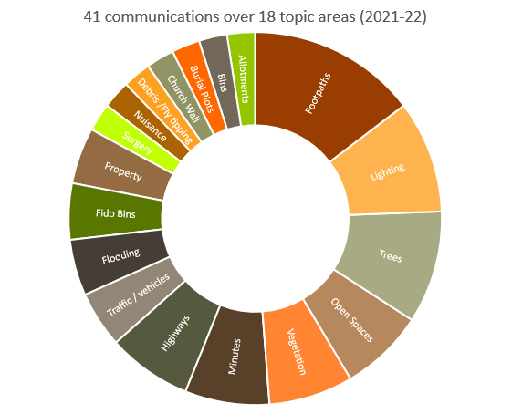
Communication with the Parish Council
AVM data | 2022
Allotments | 1
Bins | 1
Burial Plots | 1
Church Wall | 1
Property | 2
Debris /Fly tipping | 1
Fido Bins | 2
Flooding | 2
Footpaths | 6
Highways | 3
Minutes | 3
Nuisance | 1
Surgery | 1
Traffic / vehicles | 2
Vegetation | 3
Trees | 4
Open Spaces | 3
Lighting | 4
Total | 41
Notes:
Hot topics Footpaths (6), Lighting (4) and trees (4)

Slide 11
Planning Applications
60 new applications in the past year
19 applications related to trees within the conservation area
5 applications were refused by BDC within the year
Notes:
Time for a comfort break before moving to the guest speakers.

Slide 12
SBPC Neighbourhood Plan
Notes:
Time for a comfort break before moving to the guest speakers.

Slide 13
Presentation from Village Groups and Guest Speakers
Running Order
Mary Nicholls (Head) – Steeple Bumpstead Primary School
Annie Turner – Congregational Church
Chris Bailey – 1st Steeple Bumpstead Scout Group
Brenda Pennycook – Ladies Social Circle
Dave Kuyper – Bowls Club
Paul Sullivan – SB Golf Society
Jan Hall – Bingo
Kerry Barnes – The Steeple Chasers Running Group
Notes:
Are there any others?

Slide 14
Reports from those unable to attend to be read by others
Steeple Bumpstead Neighbourhood Network – Catherine Condie

Slide 15
SBNN– Catherine Condie
Steeple Bumpstead Neighbourhood Network
Steeple Bumpstead Neighbourhood Network was set up in March 2020 as an immediate response to the lockdown.
In its first year, teams of street volunteers and a prescription rota team supported a sizeable proportion of the community. (We reported numbers at the last village meeting.) The need for this help was made greater with the immediate closure of the surgery at a time when residents were unprepared.
The prescription rota team worked to cover collections for families self isolating, the elderly and those without access to the internet or transport for almost a year and a half.
Street volunteers and a much wider network of helpers across the village supported each other in their immediate surroundings with shopping, errands and much more.

Slide 16
SBNN– Continued…
In summer 2021, the regular prescription rota team scaled back its collections and the Neighbourhood Network street volunteers became main points of contact for help. The gradual opening up, and an increase in confidence across the country has enabled residents to find alternative means to access medical help and to venture into the shops.
This has meant that volunteers are now helping just those that need it most. We are still in operation but in a much smaller capacity. Importantly, our set-up across streets means we can remobilise quickly and easily. The Facebook information page retains its village-wide audience and is still active.
In September, we were pleased to be asked to host a visit to Steeple Bumpstead from the Chairman of Braintree District Council, Sue Wilson and District Councillor, Diana Garrod. Both were impressed with the village-wide effort and have maintained contact with us.
The Neighbourhood Network volunteers would like to thank everyone in the village who has supported this community initiative in some way.
Catherine Condie

Slide 17
Next Meeting Wednesday 19th April 2023 at The Village Hall
Notes:
To include housekeeping and reference to no meeting last year ergo no minutes to confirm. The minutes from this meeting will be agreed at the PC meeting in June.

Slide 18
Steeple Bumpstead Parish Council
www.steeplebumpstead-pc.org
Notes:
Chairman to close the meeting

