Slide 1
A year in operation
Launched 12 April 2020
3 village leaflet drops, 15 village posters
3 focused WhatsApp groups for volunteers
278 Facebook Group members, 641 information posts, 529 comments
Links with Steeple Bumpstead Parish Council, Braintree DC, Essex CC, Essex Coronavirus Action, Citizens’ Advice Bureau, St Mary’s Steeple Bumpstead, and more
Publication of Network Guidelines and online Safeguarding training for volunteers
Grant funding support from Braintree District Council for IT and other projects
Dedicated email and telephone line, working alongside the street volunteer system

Slide 2
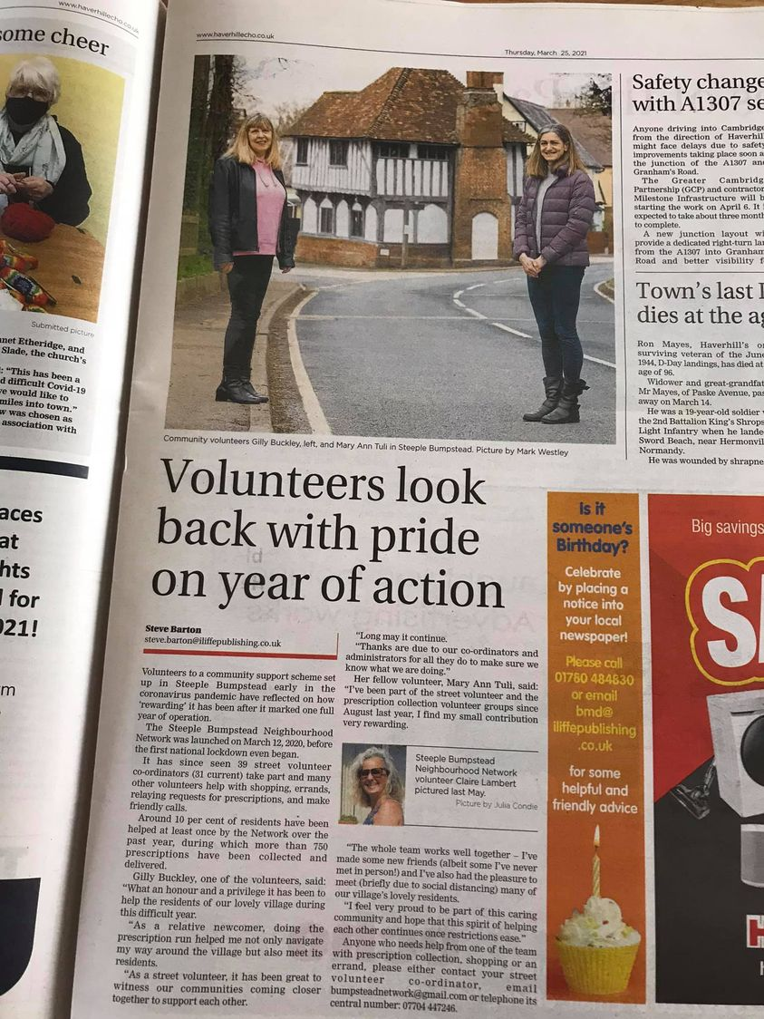
Our achievements
➢ 4 Yellow Book articles, 3 newspaper articles
39Carole Jones, Joanne Donegan and 37 others
8 comments
Like
Comment
39 street volunteer co-ordinators (31 current) and many other volunteers
42 roads/areas covered
12 prescription rota team volunteers (5 current, 3 cover), 60 permissions, 5-day service
150+ residents helped at least once
750 prescription deliveries

